Slide 1



R. Jean-Marie Charles, DMin, Ph.D .Candidate

Slide 2
Leadership
Leadership—The path of men who are placed as leaders is not an easy one. But they are to see in every difficulty a call to prayer.
Ellen G. White. Christian Leadership (p. 9). Copyright © 2010, Ellen G. White Estate, Inc.. Kindle Edition.

Slide 3
Leader characteristics :
ethic
Honesty
Passion
Humility
courage

Slide 4
Leadership—The path of men who are placed as leaders is not an easy one. But they are to see in every difficulty a call to prayer. Ellen G. White. Christian Leadership (p. 9). Copyright © 2010, Ellen G. White Estate, Inc.. Kindle Edition.

Slide 5
Lord’s Business Demands Order—The Lord is not pleased with the present lack of order and accuracy among those who do business in connection with His work… Everything that bears any relation to the work of God should be as nearly perfect as human brains and hands can make it.—Gospel Workers, 460.
Ellen G. White. Christian Leadership (p. 6). Copyright © 2010, Ellen G. White Estate, Inc.. Kindle Edition.

Slide 6
Looking to Jesus—No man is so high in power and authority but that Satan will assail him with temptation. And the more responsible the position a man occupies, the fiercer and more determined are the assaults of the enemy.
Ellen G. White. Christian Leadership (p. 9). Copyright © 2010, Ellen G. White Estate, Inc.. Kindle Edition.

Slide 7
https://www.youtube.com/watch?v=AvxwS_X2Bqg

Slide 8
https://www.youtube.com/watch?v=Rd0kf3wd120

Slide 9
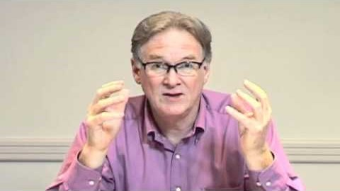

Slide 10


Slide 11
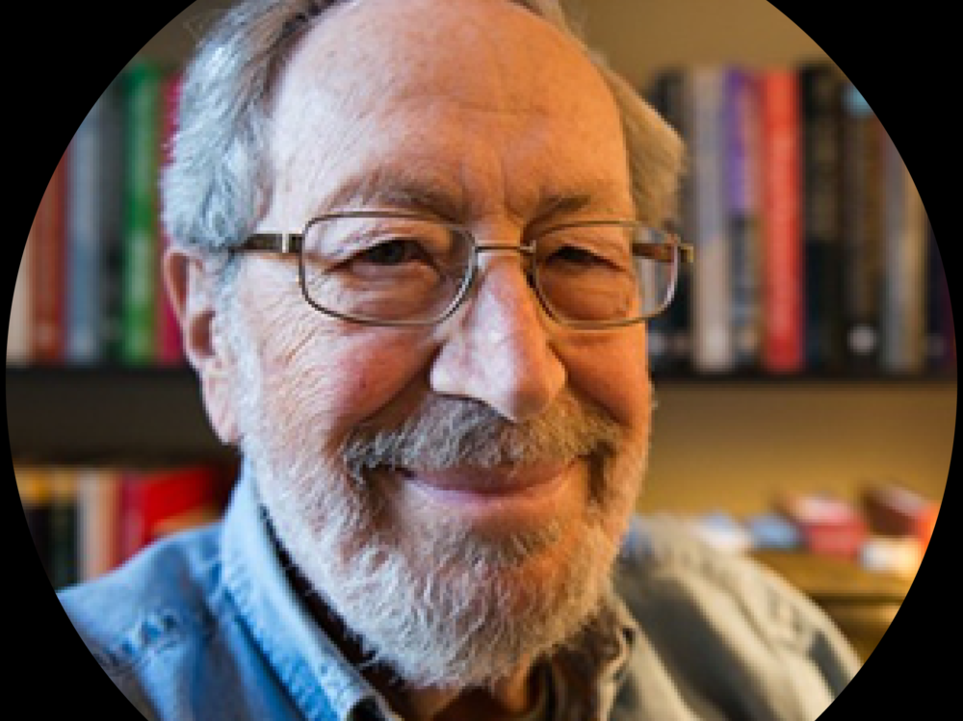
Edgar Henry Schein, Ph.D. Harvard University
Organizational culture

Slide 12

Levels of Organizational Culture
Artifacts - symbols of
culture in the physical
and social work environment (Visible)
Values
Espoused: what members of
an organization say they value
Enacted: reflected in the way
individuals actually behave
Assumptions - deeply held
beliefs that guide behavior and tell
members of an organization how
to perceive and think about things
Notes:
Organizational culture can be developed in many ways. IDEO is a respected design firm that helps companies create an innovative culture through the development of sophisticated products and “workplace environments.” Visit IDEO to explore ways in which the firm’s products and services help contribute to corporate culture at various levels.

Slide 13
Functions of Organizational Culture
Culture provides a sense of identity to members and increases their commitment to the organization
Culture reinforces the values in the organization
Culture serves as a control mechanism for shaping behavior

Slide 14
Edgar Schein proposes a conceptual model for culture change.
Change creates learning anxiety (leaving what we know to something we don’t).
This learning anxiety can be fueled by any of the following (valid) reasons:
1. Fear of loss of power/position,
2. Fear of temporary incompetence, fear of subsequent punishment,
3. Fear of loss of personal identity and fear of loss of group membership.
4. The higher the learning anxiety, the stronger the resistance and the defensiveness.

Slide 15
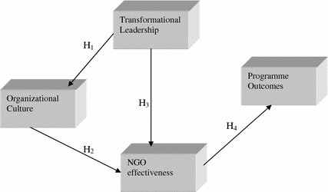

Slide 16
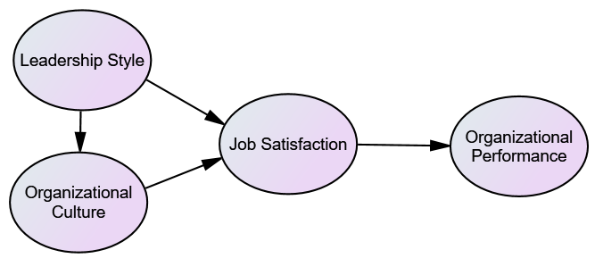
Model from:
Yodhika Widya Ariyawan, Abdul Rivai, Suharto

Slide 17
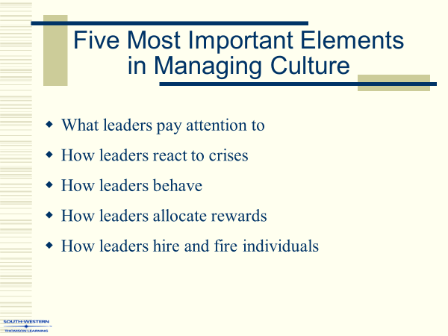

Slide 18
Les apÔtres et la culture de l’Église primitive

Slide 19
Acts 1:14, Atcs 2: 1 acts 3: 1 Acts 6

Slide 20
Atcs 6: 1 En ce temps-là, le nombre des disciples augmentant, les Hellénistes murmurèrent contre les Hébreux, parce que leurs veuves étaient négligées dans la distribution qui se faisait chaque jour.

Slide 21
2 Les douze convoquèrent la multitude des disciples, et dirent: Il n'est pas convenable que nous laissions la parole de Dieu pour servir aux tables.

Slide 22
3 C'est pourquoi, frères, choisissez parmi vous sept hommes, de qui l'on rende un bon témoignage, qui soient pleins d'Esprit Saint et de sagesse, et que nous chargerons de cet emploi.

Slide 23
4 Et nous, nous continuerons à nous appliquer à la prière et au ministère de la parole.

Slide 24
Paul
1Thess. 5: 17 Priez sans cesse

Slide 25
1thess. 3: 13 afin d'affermir vos coeurs pour qu'ils soient irréprochables dans la sainteté devant Dieu notre Père, lors de l'avènement de notre Seigneur Jésus avec tous ses saints!

